Slide 1
hacking
the
micro:bit
Notes:
This is a relatively new hardware platform - a tiny board (a bit like the raspberry pi) but
with bluetooth, compass, tiny display, accelerometer.

Slide 2
micro:bit?
Notes:
This is a relatively new hardware platform - a tiny board (a bit like the raspberry pi) but
with bluetooth, compass, tiny display, accelerometer.

Slide 3


Slide 4
A “Real” Machine
Tiny computer
Cheap & Robust
Choice of programming languages
USB or battery powered
Easy to get started

Slide 5
Simple &
Creative &
Complicated

Slide 6
Notes:
Project lead, knitted memory, prevented crash.

Slide 7
More powerful than
the Apollo 11
computers

Slide 8
Accelerometer
Display
Digital IO
Buttons
Radio

Slide 9
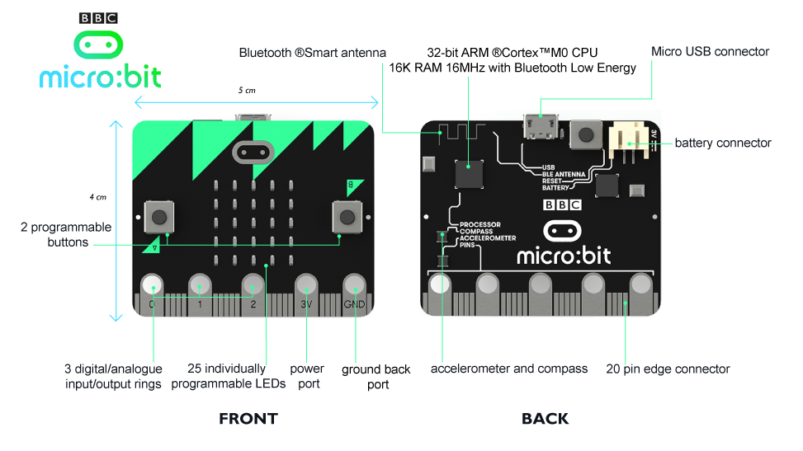
Notes:
This is what it looks like. Buttons and display on the front. Reset button and connector port on the back

Slide 10
http://codewith.mu
Notes:
This is the special editor we will use. It is designed specifically to work with the micro bit and understands how to download programs to it.

Slide 11
python
Beginner friendly
Text-based
Simple syntax
Interpreted

Slide 12
micro python
Lighter
Lower memory
micro:bit-specific functions

Slide 13
micro punctuation
Punctuation
Indenting
Spacing
Spelling

Slide 14
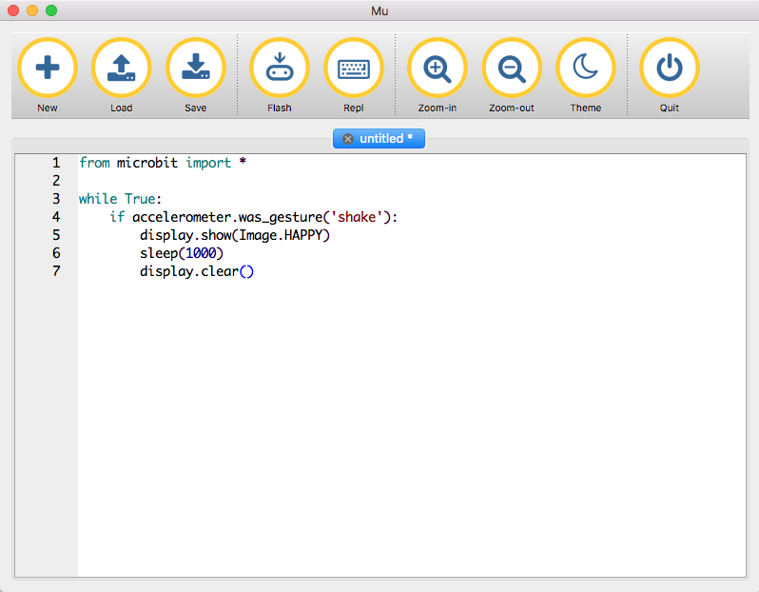
Notes:
Flash button is most important. Downloads program to device. Watch yellow light blink while that happens. The program will start to run. Or will show an error if it can’t make sense of the program.

Slide 15
micro:bit & python
Dedicated processing
Runs one program at a time - yours
Runs code (mostly) top to bottom
Does what you say, not what you think you said
Easy (easier) to reason about
Easier to debug when things go wrong

Slide 16
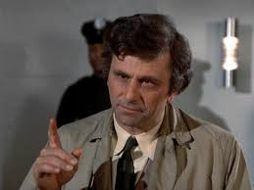
Errors
Python is interpreted
Errors shown one by one
Errors will scroll across the screen
(Can be) hard to read on device
Write them down (if you can)
Use the Reset button on the back
Notes:
microbit errors will scroll across the screen. they can be a bit difficult to read but if you lose the thread of what it’s trying to tell you, you can hit the reset button and it will try again.

Slide 17
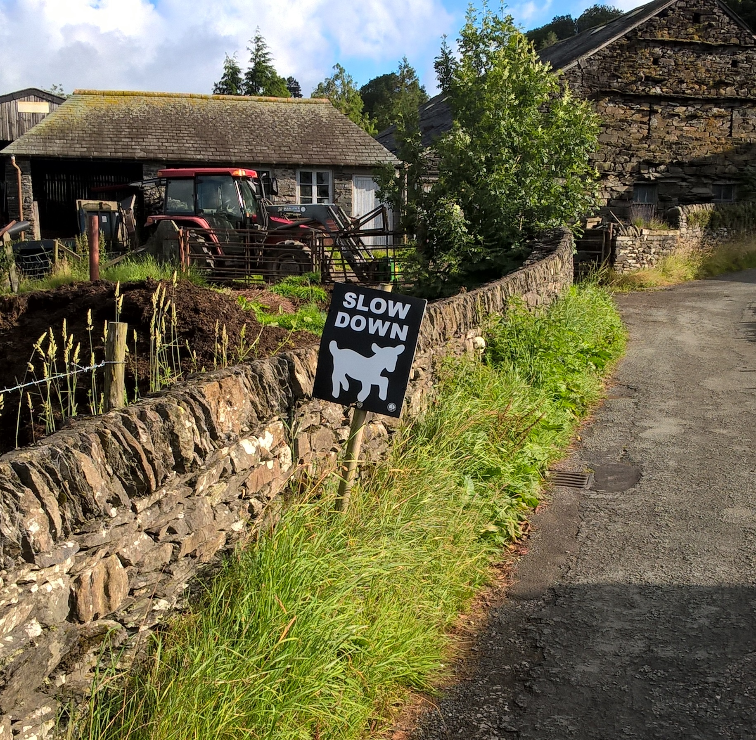
Our Process
Write a little bit of code
Download it (“Flash”)
See what it does
Repeat
Notes:
Where Scratch hid a lot of complexity behind snap together lego pieces, we
are going to be writing closer to actual instructions.
Where Scratch was interpreting our commands "live" and we could make changes that were instantly reflected in the behaviour of the program, Micro Python is a compiled language and follows a different lifecycle. We write code in text, we send the code down to the device where it is compiled into it's own internal representation, then the program executes.
This is faster to run and only needs to be downloaded once for each version, but it's not as reactive and live as Scratch.

Slide 18
Let’s get connected
Notes:
Plug cable into usb and plug other end into the port on the board. Don’t worry about touching it, you won’t get a shock and you won’t break anything.
The lead gives the unit power so keep it connected at all times.
Things to note - the display on one side. Two buttons left and right are a and b. The connector on the back and next to it a reset button. If everything is going wrong you can press that to restart your program.

Slide 19
micro:bit functions
from microbit import *

Slide 20
Smallest Possible Program
from microbit import *
display.scroll('hello')
Notes:
be careful of spelling, case, punctuation and spacing (indenting) Flash and watch yellow light. Program starts immediately

Slide 22
Larger Program
from microbit import *
# variable
greeting = ‘hi’
display.scroll(greeting)
Notes:
Change the greeting and re-flash
Contrived example to show variable - could be read from a keyboard or from internet or something.

Slide 23
Variables?
temperature = read_temp()
display.scroll(str(temperature))
Notes:
We can read the temp from outside without having to change the program, temperature is a placeholder for a value. We use that name in place of having to write 100 or 50 or whatever.

Slide 24
from microbit import *
greeting = ‘hi’ # more
name = ‘derek’ # variables
age = 19
display.scroll(greeting)
display.scroll(“My name is”)
display.scroll(name)
display.scroll(“I am”)
display.scroll(str(age))
Notes:
Change the greeting and re-flash

Slide 25
Another Program
display.show(Image.HAPPY)
sleep(5000)
display.show(Image.ASLEEP)
Notes:
Delays
Pre-built images. List is quite long, try some different ones.

Slide 26
A few times…
# do it 3 times
for times in range(0, 3):
display.show(Image.HAPPY)
sleep(1000)
display.show(Image.ASLEEP)
sleep(1000)
display.scroll(‘done’)
Notes:
Notice indenting and does loop 3 times. Colon at the end of for

Slide 27
Forever
while True:
display.show(Image.HAPPY)
sleep(1000)
display.show(Image.ASLEEP)
sleep(1000)
display.scroll(‘done’)
Notes:
Notice indenting, colon and never comes back from this loop.
True is a proper name, must be this case.
Code put at the end of the loop never executes

Slide 28
Acclerometer

Slide 29
Accelerometer
x_tilt = accelerometer.get_x()
y_tilt = accelerometer.get_y()
# all on one line…
display.scroll(“x: “ + str(x_tilt)
+ “y: “ + str(y_tilt))
Notes:
Str convert value to string to be able to display

Slide 31
Cyber-Pet
from microbit import *
# Shake to wake your pet up
while True:
if accelerometer.was_gesture("shake"):
display.show(Image.HAPPY)
sleep(5000)
else:
display.show(Image.ASLEEP)
Notes:
Notice if and colon and else and colon
Could also have elif:
# try ‘face up’ or ‘face down’

Slide 32
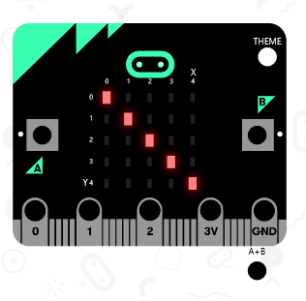
Notes:
Now let's wait for a few seconds then turn the lights off again. We go to the basic
section again and drag on a pause block. Let's click in the box and change the 100 to 500
(half a second).

Slide 33
Your Image?
smiley = Image(
“00000:"
“09090:"
“00000:"
“90009:"
“09990")
display.show(smiley)
Notes:
Custom images, brightness and shades of grey. Colons are important. Make your own picture.

Slide 34
Buttons
from microbit import *
while True:
if button_a.was_pressed():
display.scroll('A')
elif button_b.was_pressed():
display.scroll('B')
sleep(100)
Notes:
is_pressed vs was_pressed? timing
Note extra indenting - two levels here.

Slide 35
Notes:
Including everything makes for big programs, need to be selective and use only what we need. Import

Slide 36
Randomness
import random
words = [‘one’, ‘two’, ‘three’]
word = random.choice(words)
display.scroll(word)
Notes:
Import random - not used otherwise
List, picks one of a list. [ in pairs ] list comma delimited. Can change content of words but without having to change the rest of the program.

Slide 37
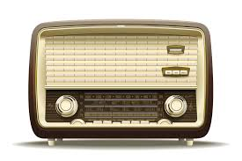
Notes:
Radio is one of the most fun parts of the microbic

Slide 38
Radio
import radio
radio.on()
to_send = “hello”
while True:
if button_a.was_pressed():
radio.send(to_send)
received = radio.receive()
if received:
display.scroll(received)
Notes:
Radio is expensive, turn on when necessary. Send broadcasts to local area and receive receives from any one. Must check message before using.

Slide 39
Notes:
Can do simple animation on the display in a number of different ways.
Each frame is structured in a list to make it look like movement. We can do the same thing…

Slide 40
from microbit import *
small_heart = Image (“00000:05550:05650:05550:00000:")
big_heart = Image (“09090:99999:99999:09990:00900:")
heartbeat = [
small_heart,
big_heart,
small_heart,
big_heart,
small_heart,
small_heart
]
display.show(heartbeat, loop=True, delay=250)
Notes:
An example I made for my wife… list of images and display cycles through them, loop and delay between each frame

Slide 42
Functions
def say_something():
display.scroll(‘hi’)
say_something()
Notes:
Reusable chunks of code
Must come first before being used so python sees them and puts them away
Arguments
Return values

Slide 43
Functions
def say_something(message):
display.scroll(message)
say_something(‘hey’)
say_something(‘hi’)
say_something(‘hello’)
Notes:
Reusable chunks of code
Arguments
Return values

Slide 44
Functions
def is_it_bob(name):
return name == “bob”
if is_it_bob(person_name):
display.scroll(‘hi bob’)
Notes:
Reusable chunks of code
Arguments
Return values

Slide 45
Write a Program
Find a partner (or two)
Pick an activity sheet
…or use your own idea
Build & Test it
Extend it
Explain it
Notes:
Talk about how it went, what you built, how you built it, what was easy, what was hard.

Slide 46
Notes:
Technology changes with fashion, principles do not. Same skills Margaret Hamilton used are what we have used today but computer could not be more different.

